Slide 1
MARKET PERFORMANCE,
HEALTHCARE &
SPY STOCK-OPTION PRICES
PIRUZ ALEMI, EDWARD JOSEPH, MARTHA KARRAN
December 11, 2019 - Columbia University

Slide 2
PROJECT OVERVIEW
Primary Questions:
How much are Healthcare Stocks/Options tied to the overall performance of the stock market?
How are Healthcare or SPY Option values derived? Are these Options over or under-priced?
Other questions:
What is the relationship between the market indicators?
What is the relationship between the market indicators and the healthcare stocks?
How much of healthcare stock performance can be attributed to market performance?
How much of healthcare stock performance can be attributed to performance within the pharmaceutical industry?
Notes:
We are looking at the relationship between the performance of the market and the performance of select healthcare companies. We are interested in the correlations between the market indicators and the stock prices of each company. We expect that each healthcare company will be more correlated with the pharmaceutical ETF than the other market indicators. And we expect that the variance of these healthcare companies will be explained more by the IHE than the other market indicators.

Slide 3
DATA COLLECTION & GENERATION
Past Stock market data was downloaded from Yahoo Finance: SPY, IHE, VIX, GILD, JNJ, LLY, PFE, SYK, MSFT
For SPY example see: https://finance.yahoo.com/quote/SPY?p=SPY&.tsrc=fin-srch-v1
From December 2018 to December 2019
Future Stock prices were generated over a million different paths for 20 days forward contracts, using Pandas_Python InterTools Library
Here, we report on a 5 day forward contract
For the theory of Option-Pricing, see: John C. Hull’s classic textbook, “Derivatives Options, Futures and Other Derivatives”

Slide 4
DATA CLEANING AND PREPARATION
Since CSVs were generated by Yahoo Finance’s website, data cleaning was minimal
Preparing datasets for analyses
Renaming columns
Sorting by Date
Converting date to datetime format (instead of string)
Deriving growth rates
Percent change from the first data point for each dataset

Slide 5
KEY ACRONYMS
SPY – an Exchange-Traded Fund (ETF) of S&P 500; weighted measure of the stock performance of 500 large companies
IHE – a Pharmaceutical ETF: https://www.ishares.com/us/products/239519/ishares-us-pharmaceuticals-etf
As of Dec 2019, it has 2,000,000 shares outstanding
VIX – a key Index measure of Volatility of S&P 500; highlights moments of crisis
Healthcare Stocks
GILD - Gilead Sciences
JNJ - Johnson & Johnson
LLY - Eli Lilly and Company
PFE - Pfizer
SYK - Stryker

Slide 6
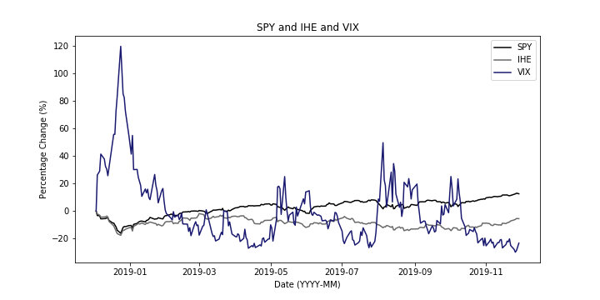
MARKET INDICATORS
Notes:
Visualizing what we refer to as the market indicators

Slide 7
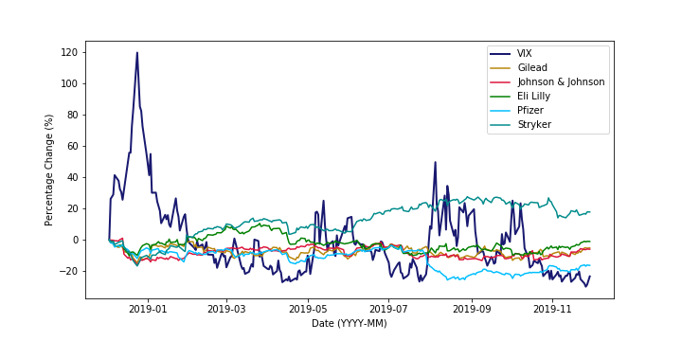
VIX AND HEALTHCARE STOCKS
Notes:
Looking at VIX and the healthcare stocks

Slide 8
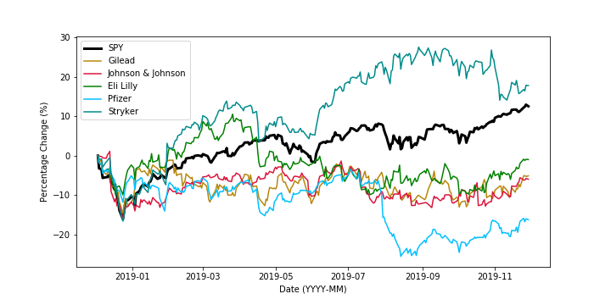
SPY AND HEALTHCARE STOCKS
Notes:
SPY and the healthcare stocks

Slide 9
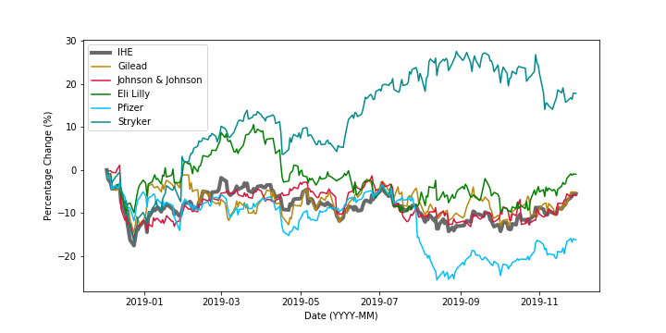
IHE AND HEALTHCARE STOCKS
Notes:
Interesting that the Pharma ETF line is closer to the group of pharma companies than the SPY line. Certainly expected but nice to see the visual representation of the difference

Slide 10
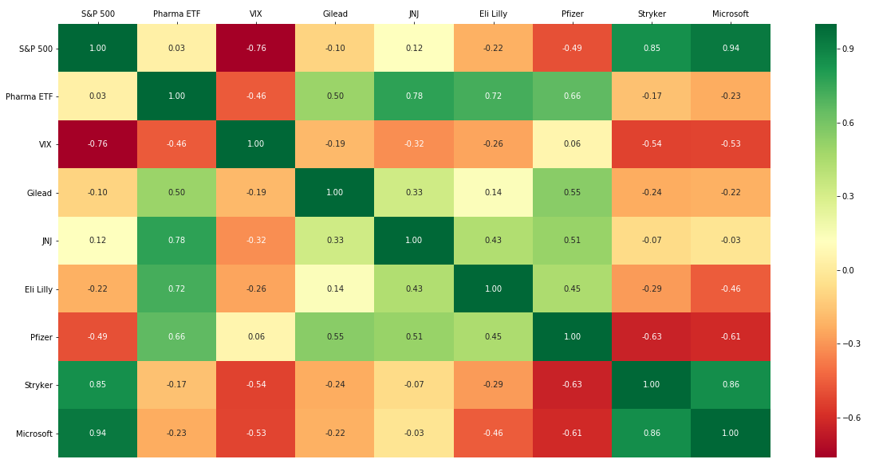
Correlation Matrix
Notes:
We were able to answer our questions but time was certainly a limitation for us
With python we were able to create a correlation matrix.
On the right we have a color bar
Red for negative correlations
Green for positive
Yellow and orange indicating very weak relationships
We found that each pharmaceutical company was more correlated with the IHE than with SPY or VIX.
Similarly we found that the variance in each healthcare company was explained by the IHE than by SPY.
A few of note:
Talk about JNJ in IHE - JNJ is about 20% of the pharma ETF so this strong correlation makes sense
Talk about Stryker, a med device company is not part of the IHE but it is in the healthcare industry, so it’s stronger correlation with SPY versus the Pharma ETF is interesting
Talk about Microsoft in SPY - we added Microsoft because it comprises about 20% of the S&P 500.

Slide 11
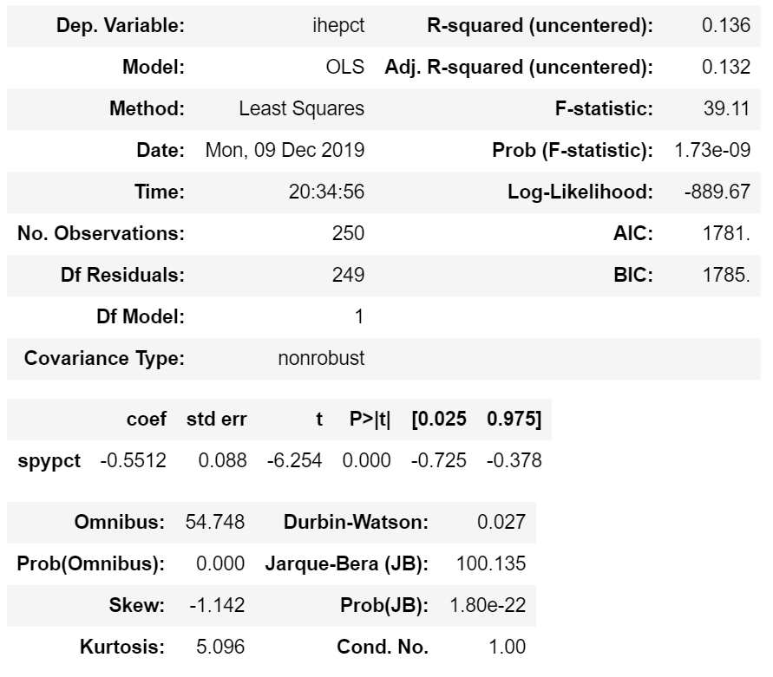
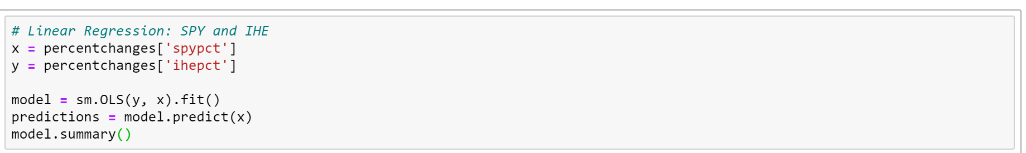
REGRESSION ANALYSES
Linear regressions and multiple linear regressions
Here, we present the R-squared for the models
R-squared: the proportion of the variance for a dependent variable that is explained by an independent variable (or variables) in a regression model
The output of a linear regression in Python (right)
Code for linear regression (below)
Multiple linear regression adds more IVs

Slide 12
REGRESSION ANALYSES - Market Indicators
Linear regression analyses between the market indicators were performed:
As expected, the variance in the Pharma ETF did not appear to be explained by the variance in the S&P 500 or VIX (indicated by a very small R-squared)
Also as expected, some of the variance in the S&P 500 can be explained by variance in the VIX
Independent Variable | Dependent Variable | R-squared
S&P 500 | Pharma ETF | 0.136
VIX | Pharma ETF | 0.012
VIX | S&P 500 | 0.516

Slide 13
REGRESSION ANALYSES
Each healthcare company is more associated with the Pharma ETF than with the S&P 500.
Independent Variable | Dependent Variable | R-squared
S&P 500 | Gilead | 0.167
 | JNJ | 0.108
 | Eli Lilly | 0.131
 | Pfizer | 0.320
 | Stryker | 0.668
Independent Variable | Dependent Variable | R-squared
Pharma ETF | Gilead | 0.883
 | JNJ | 0.940
 | Eli Lilly | 0.416
 | Pfizer | 0.878
 | Stryker | 0.557

Slide 14
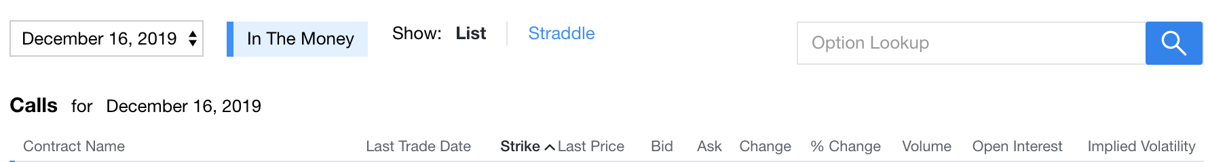
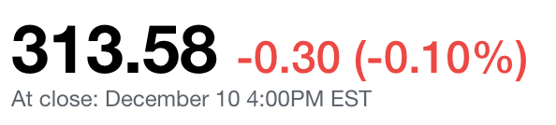
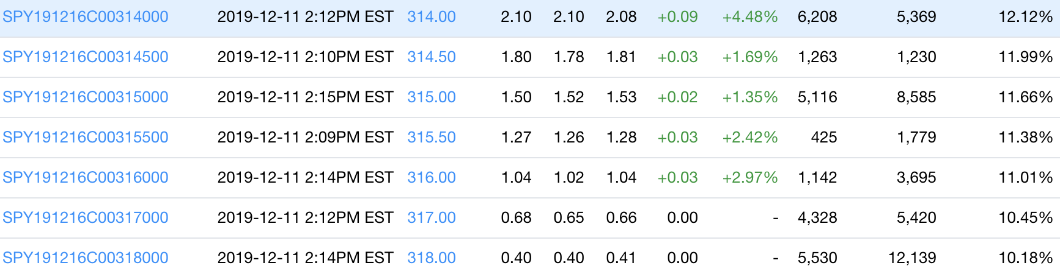
What should be the value of a “SPY" Call option bought today and exercised five or n days later, if current Stock = 313.58?

Slide 15
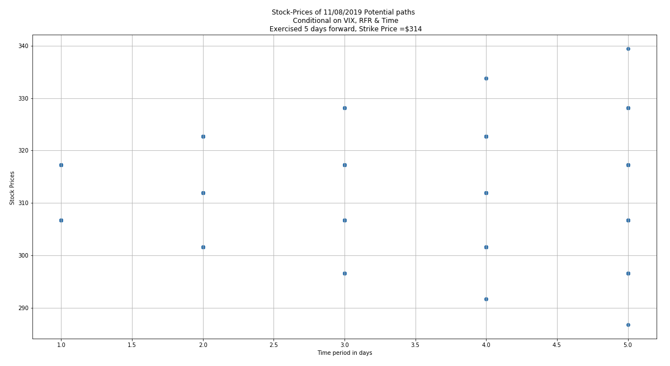
The Value of an option is derived from its underlying Stock price.
Each Node constitutes an Object, whose attributes we traced through time.
Note: A call option to be exercised 20 days later, traverses 1,048,576 paths of Stock Prices.

Slide 16
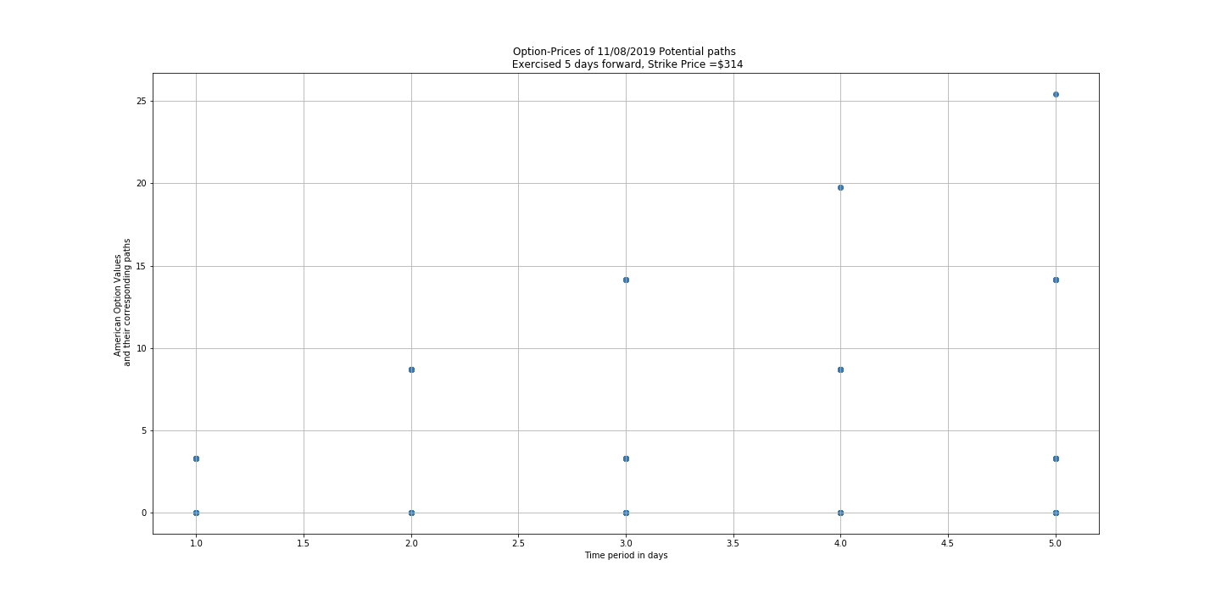
Value of an SPY Call option bought on Dec 8th, 2019 with a strike price of $314 exercised 5 days Forward, traced, forward then backward.

Slide 17
POST-MORTEM
Reduce redundancy in correlation matrix
Investigate Eli Lilly (relatively smaller R-squared, though part of the Pharma ETF)
Look at the differences between Pharmaceutical companies and Medical Device companies
Time series regression
Incorporate news for each company to assess dips and spikes
Improve American option pricing probabilities

Slide 18
Questions?

Slide 19
A debt of gratitude to
Ilya Altshteyn, Terry Huang, Ju Chen and Vitor Kitaigorodsky
for their critical help and support of this project.
THANK YOU!
December 11, 2019 - Columbia University

